Slide 1
Java 8. Stream API. Optional. LocalDate

Slide 2
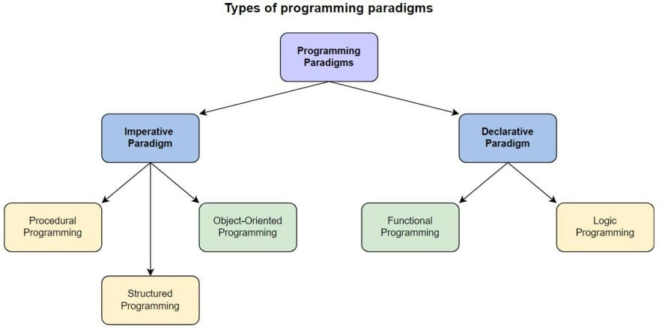
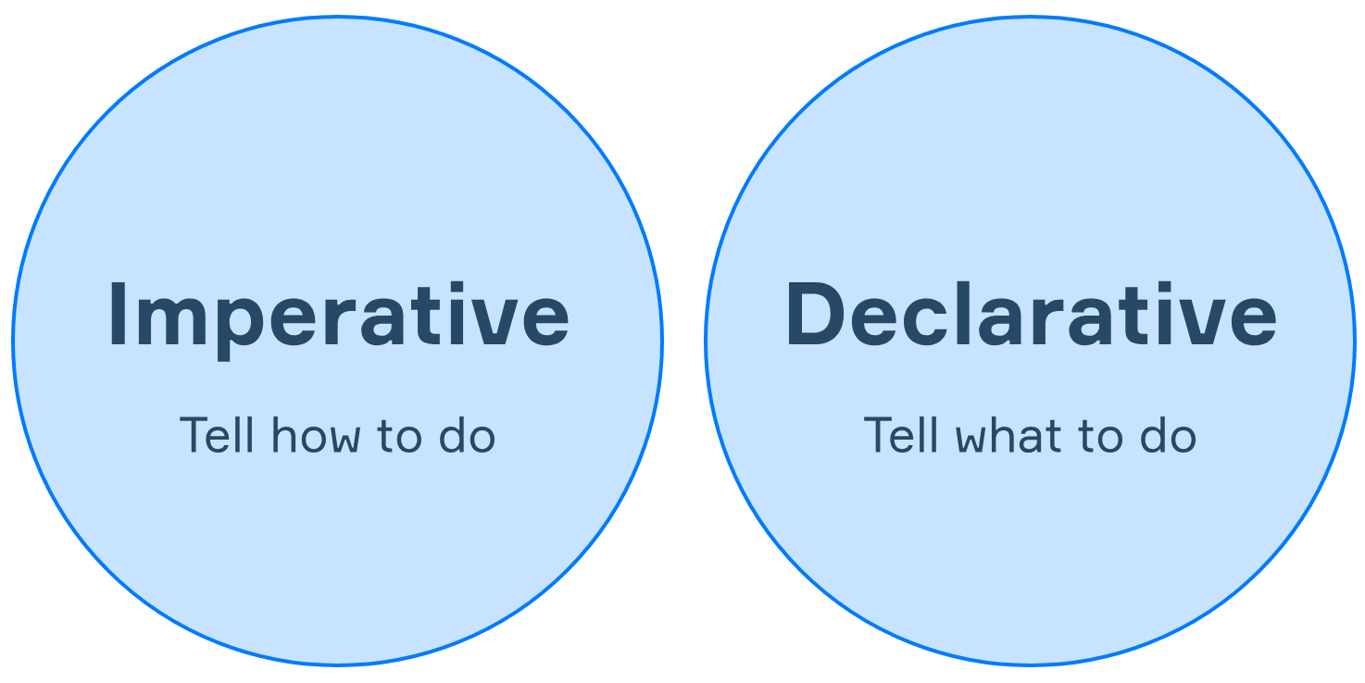

Slide 3
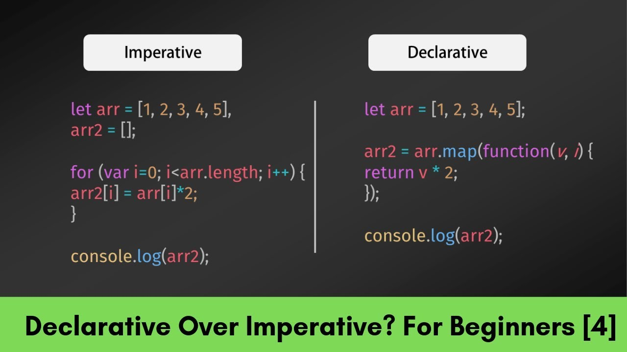

Slide 4
public class InnerClass { Function<Object, String> f = new Function<Object, String>() { @Override public String apply(Object obj) { return obj.toString(); } }; }
public class Lambda { Function<Object, String> f = obj -> obj.toString(); }

Slide 5
public static List<Apple> filterApples(List<Apple> inventory, Predicate<Apple> p) { List<Apple> result = new ArrayList<>(); for (Apple apple : inventory) { if (p.test(apple)) { result.add(apple); } } return result; }
public static List<Apple> filterGreenApples(List<Apple> inventory) { List<Apple> result = new ArrayList<>(); for (Apple apple : inventory) { if ("green".equals(apple.getColor())) { result.add(apple); } } return result; }
// [Apple{color='green', weight=80}, Apple{color='green', weight=155}] List<Apple> greenApples = filterApples(inventory, FilteringApples::isGreenApple); System.out.println(greenApples); // [Apple{color='green', weight=155}] List<Apple> heavyApples = filterApples(inventory, FilteringApples::isHeavyApple); System.out.println(heavyApples);
public static List<Apple> filterHeavyApples(List<Apple> inventory) { List<Apple> result = new ArrayList<>(); for (Apple apple : inventory) { if (apple.getWeight() > 150) { result.add(apple); } } return result; }
public static boolean isGreenApple(Apple apple) { return "green".equals(apple.getColor()); } public static boolean isHeavyApple(Apple apple) { return apple.getWeight() > 150; }
@FunctionalInterface public interface Predicate<T> { boolean test(T t);
}

Slide 6
public static final List<Dish> menu = Arrays.asList( new Dish("pork", false, 800, Dish.Type.MEAT), new Dish("beef", false, 700, Dish.Type.MEAT), new Dish("chicken", false, 400, Dish.Type.MEAT), new Dish("french fries", true, 530, Dish.Type.OTHER), new Dish("rice", true, 350, Dish.Type.OTHER), new Dish("season fruit", true, 120, Dish.Type.OTHER), new Dish("pizza", true, 550, Dish.Type.OTHER), new Dish("prawns", false, 400, Dish.Type.FISH), new Dish("salmon", false, 450, Dish.Type.FISH) );
public static List<String> getLowCaloricDishesNamesInJava7(List<Dish> dishes) { List<Dish> lowCaloricDishes = new ArrayList<>(); for (Dish d : dishes) { if (d.getCalories() < 400) { lowCaloricDishes.add(d); } } List<String> lowCaloricDishesName = new ArrayList<>(); Collections.sort(lowCaloricDishes, new Comparator<Dish>() { @Override public int compare(Dish d1, Dish d2) { return Integer.compare(d1.getCalories(), d2.getCalories()); } }); for (Dish d : lowCaloricDishes) { lowCaloricDishesName.add(d.getName()); } return lowCaloricDishesName; }
public static List<String> getLowCaloricDishesNamesInJava8(List<Dish> dishes) { return dishes.stream() .filter(d -> d.getCalories() < 400) .sorted(comparing(Dish::getCalories)) .map(Dish::getName) .collect(toList()); }

Slide 7
// Stream.of Stream<String> stream = Stream.of("Java 8", "Lambdas", "In", "Action"); stream.map(String::toUpperCase).forEach(System.out::println);
long uniqueWords = Files.lines(Paths.get("lambdasinaction/chap5/data.txt"), Charset.defaultCharset()) .flatMap(line -> Arrays.stream(line.split(" "))) .distinct() .count();
// Stream.empty Stream<String> emptyStream = Stream.empty();
// Arrays.stream int[] numbers = { 2, 3, 5, 7, 11, 13 }; System.out.println(Arrays.stream(numbers).sum());
// Stream.iterate Stream.iterate(0, n -> n + 2) .limit(10) .forEach(System.out::println);
// random stream of doubles with Stream.generate Stream.generate(Math::random) .limit(10) .forEach(System.out::println); // stream of 1s with Stream.generate IntStream.generate(() -> 1) .limit(5) .forEach(System.out::println);

Slide 8
public static final List<Dish> menu = Arrays.asList( new Dish("pork", false, 800, Dish.Type.MEAT), new Dish("beef", false, 700, Dish.Type.MEAT), new Dish("chicken", false, 400, Dish.Type.MEAT), new Dish("french fries", true, 530, Dish.Type.OTHER), new Dish("rice", true, 350, Dish.Type.OTHER), new Dish("season fruit", true, 120, Dish.Type.OTHER), new Dish("pizza", true, 550, Dish.Type.OTHER), new Dish("prawns", false, 400, Dish.Type.FISH), new Dish("salmon", false, 450, Dish.Type.FISH) );
List<Dish> specialMenu = Arrays.asList( new Dish("season fruit", true, 120, Dish.Type.OTHER), new Dish("prawns", false, 300, Dish.Type.FISH), new Dish("rice", true, 350, Dish.Type.OTHER), new Dish("chicken", false, 400, Dish.Type.MEAT), new Dish("french fries", true, 530, Dish.Type.OTHER));
List<Dish> filteredMenu = specialMenu.stream() .filter(dish -> dish.getCalories() < 320) .collect(toList());
// Filtering with predicate System.out.println("Filtering with a predicate"); List<Dish> vegetarianMenu = menu.stream() .filter(Dish::isVegetarian) .collect(toList()); vegetarianMenu.forEach(System.out::println);
List<Dish> slicedMenu1 = specialMenu.stream() .takeWhile(dish -> dish.getCalories() < 320) .collect(toList());
public class Dish { private final String name; private final boolean vegetarian; public String getName() { return name; } public boolean isVegetarian() { return vegetarian; }
List<Dish> slicedMenu2 = specialMenu.stream() .dropWhile(dish -> dish.getCalories() < 320) .collect(toList());

Slide 9
public static final List<Dish> menu = Arrays.asList( new Dish("pork", false, 800, Dish.Type.MEAT), new Dish("beef", false, 700, Dish.Type.MEAT), new Dish("chicken", false, 400, Dish.Type.MEAT), new Dish("french fries", true, 530, Dish.Type.OTHER), new Dish("rice", true, 350, Dish.Type.OTHER), new Dish("season fruit", true, 120, Dish.Type.OTHER), new Dish("pizza", true, 550, Dish.Type.OTHER), new Dish("prawns", false, 400, Dish.Type.FISH), new Dish("salmon", false, 450, Dish.Type.FISH) );
private static boolean isVegetarianFriendlyMenu() { return menu.stream().anyMatch(Dish::isVegetarian); } private static boolean isHealthyMenu() { return menu.stream().allMatch(d -> d.getCalories() < 1000); } private static boolean isHealthyMenu2() { return menu.stream().noneMatch(d -> d.getCalories() >= 1000); } private static Optional<Dish> findVegetarianDish() { return menu.stream().filter(Dish::isVegetarian).findAny(); }

Slide 10
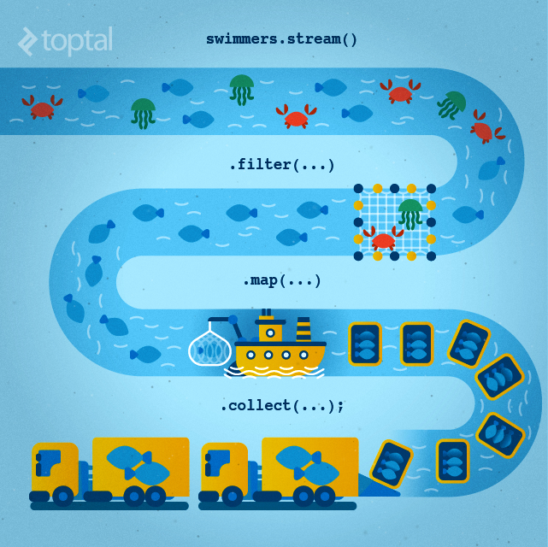
public static final List<Dish> menu = Arrays.asList( new Dish("pork", false, 800, Dish.Type.MEAT), new Dish("beef", false, 700, Dish.Type.MEAT), new Dish("chicken", false, 400, Dish.Type.MEAT), new Dish("french fries", true, 530, Dish.Type.OTHER), new Dish("rice", true, 350, Dish.Type.OTHER), new Dish("season fruit", true, 120, Dish.Type.OTHER), new Dish("pizza", true, 550, Dish.Type.OTHER), new Dish("prawns", false, 400, Dish.Type.FISH), new Dish("salmon", false, 450, Dish.Type.FISH) );
// map List<String> dishNames = menu.stream() .map(Dish::getName) .collect(toList()); System.out.println(dishNames);
[pork, beef, chicken, french fries, rice, season fruit, pizza, prawns, salmon]
// flatMap words.stream() .flatMap((String line) -> Arrays.stream(line.split(""))) .distinct() .forEach(System.out::println);

Slide 11
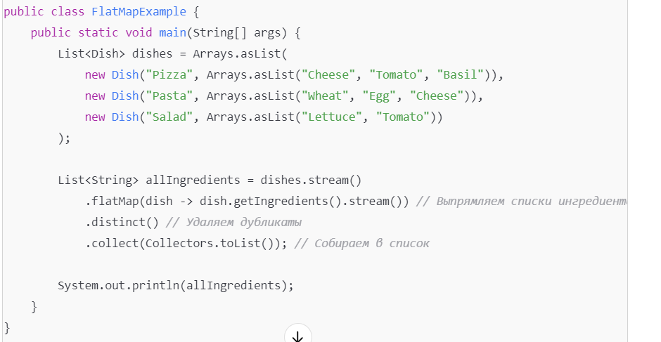
List<Integer> numbers = Arrays.asList(3, 4, 5, 1, 2); int sum = numbers.stream().reduce(0, (a, b) -> a + b); System.out.println(sum); int sum2 = numbers.stream().reduce(0, Integer::sum); System.out.println(sum2); int max = numbers.stream().reduce(0, (a, b) -> Integer.max(a, b)); System.out.println(max);

Slide 12
public static final List<Dish> menu = asList( new Dish("pork", false, 800, Dish.Type.MEAT), new Dish("beef", false, 700, Dish.Type.MEAT), new Dish("chicken", false, 400, Dish.Type.MEAT), new Dish("french fries", true, 530, Dish.Type.OTHER), new Dish("rice", true, 350, Dish.Type.OTHER), new Dish("season fruit", true, 120, Dish.Type.OTHER), new Dish("pizza", true, 550, Dish.Type.OTHER), new Dish("prawns", false, 400, Dish.Type.FISH), new Dish("salmon", false, 450, Dish.Type.FISH) );
private static Map<Dish.Type, List<Dish>> groupDishesByType() { return menu.stream().collect(groupingBy(Dish::getType)); }
private static Map<Dish.Type, List<Dish>> groupCaloricDishesByType() { return menu.stream().collect( groupingBy(Dish::getType, filtering(dish -> dish.getCalories() > 500, toList()))); }
Dishes grouped by type: {FISH=[prawns, salmon], MEAT=[pork, beef, chicken], OTHER=[french fries, rice, season fruit, pizza]}
Caloric dishes grouped by type: {FISH=[], MEAT=[pork, beef], OTHER=[french fries, pizza]}

Slide 13
public List<String> findPricesSequential(String product) { return shops.stream() .map(shop -> shop.getName() + " price is " + shop.getPrice(product)) .collect(Collectors.toList()); } public List<String> findPricesParallel(String product) { return shops.parallelStream() .map(shop -> shop.getName() + " price is " + shop.getPrice(product)) .collect(Collectors.toList()); }
public double getPrice(String product) { return calculatePrice(product); } private double calculatePrice(String product) { delay(); return random.nextDouble() * product.charAt(0) + product.charAt(1); }
[BestPrice price is 123.25651664705744, LetsSaveBig price is 169.4653393606115, MyFavoriteShop price is 214.12914480588853, BuyItAll price is 184.74384995303313]
sequential done in 4073 msecs
[BestPrice price is 197.15388829450728, LetsSaveBig price is 167.59404755738808, MyFavoriteShop price is 192.48730292081552, BuyItAll price is 199.67823140124116]
parallel done in 1013 msecs

Slide 14
public class PersonV1 { private CarV1 car; public CarV1 getCar() { return car; } }
public class CarV1 { private Insurance insurance; public Insurance getInsurance() { return insurance; } }
public class Person { private Optional<Car> car; private int age; public Optional<Car> getCar() { return car; } public int getAge() { return age; } }
public class Car { private Optional<Insurance> insurance; public Optional<Insurance> getInsurance() { return insurance; } }
public String getCarInsuranceNameNullSafeV1(PersonV1 person) { if (person != null) { CarV1 car = person.getCar(); if (car != null) { Insurance insurance = car.getInsurance(); if (insurance != null) { return insurance.getName(); } } } return "Unknown"; } public String getCarInsuranceNameNullSafeV2(PersonV1 person) { if (person == null) { return "Unknown"; } CarV1 car = person.getCar(); if (car == null) { return "Unknown"; } Insurance insurance = car.getInsurance(); if (insurance == null) { return "Unknown"; } return insurance.getName(); }
public String getCarInsuranceName(Optional<Person> person) { return person.flatMap(Person::getCar) .flatMap(Car::getInsurance) .map(Insurance::getName) .orElse("Unknown"); } public Set<String> getCarInsuranceNames(List<Person> persons) { return persons.stream() .map(Person::getCar) .map(optCar -> optCar.flatMap(Car::getInsurance)) .map(optInsurance -> optInsurance.map(Insurance::getName)) .flatMap(Optional::stream) .collect(toSet()); }

Slide 15
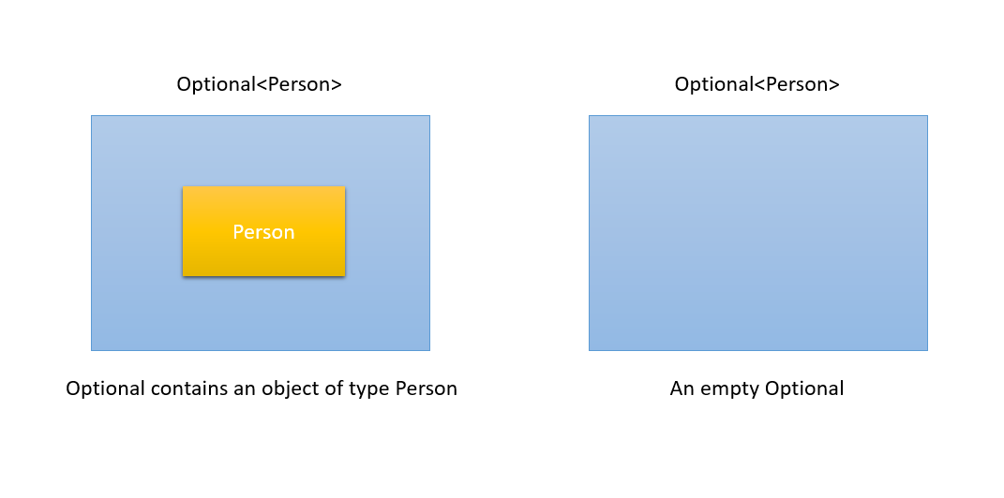

Slide 16
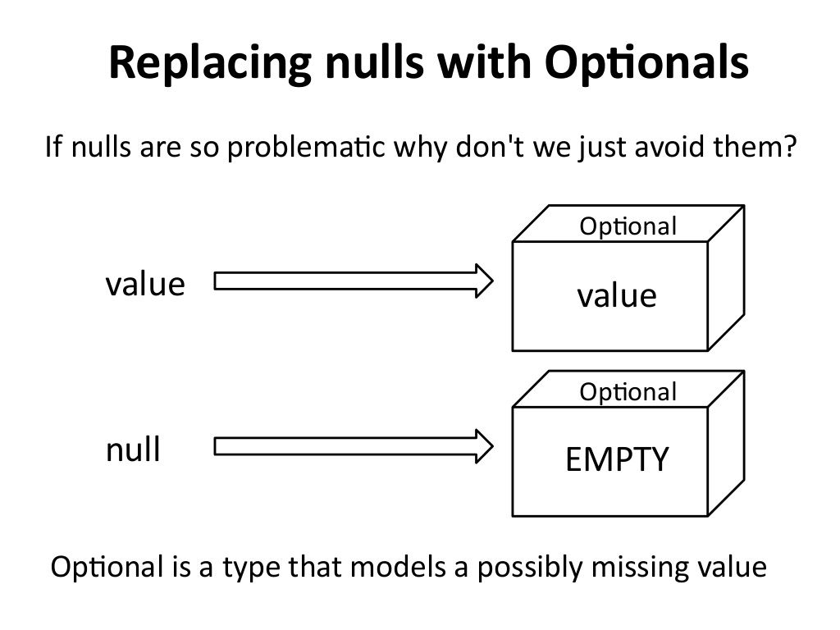

Slide 17
public Optional<Insurance> nullSafeFindCheapestInsurance(Optional<Person> person, Optional<Car> car) { if (person.isPresent() && car.isPresent()) { return Optional.of(findCheapestInsurance(person.get(), car.get())); } else { return Optional.empty(); } }
public String getCarInsuranceName(Optional<Person> person, int minAge) { return person.filter(p -> p.getAge() >= minAge) .flatMap(Person::getCar) .flatMap(Car::getInsurance) .map(Insurance::getName) .orElse("Unknown"); }
public String getCarInsuranceName(Optional<Person> person, int minAge) { return person.filter(p -> p.getAge() >= minAge) .flatMap(Person::getCar) .flatMap(Car::getInsurance) .map(Insurance::getName) .orElseThrow(() -> new NoSuchElementException("NOT FOUND")); }
public String getCarInsuranceName(Optional<Person> person, int minAge) { return person.filter(p -> p.getAge() >= minAge) .flatMap(Person::getCar) .flatMap(Car::getInsurance) .map(Insurance::getName) .orElseGet(() -> this.selectToDb()); } private String selectToDb() { //delay return "databaseQueryResult"; }

Slide 18
private static void useLocalDate() { LocalDate date = LocalDate.of(2014, 3, 18); int year = date.getYear(); // 2014 Month month = date.getMonth(); // MARCH int day = date.getDayOfMonth(); // 18 DayOfWeek dow = date.getDayOfWeek(); // TUESDAY int len = date.lengthOfMonth(); // 31 (days in March) boolean leap = date.isLeapYear(); // false (not a leap year) System.out.println(date); int y = date.get(ChronoField.YEAR); int m = date.get(ChronoField.MONTH_OF_YEAR); int d = date.get(ChronoField.DAY_OF_MONTH); LocalTime time = LocalTime.of(13, 45, 20); // 13:45:20 int hour = time.getHour(); // 13 int minute = time.getMinute(); // 45 int second = time.getSecond(); // 20 System.out.println(time); LocalDateTime dt1 = LocalDateTime.of(2014, Month.MARCH, 18, 13, 45, 20); // 2014-03-18T13:45 LocalDateTime dt2 = LocalDateTime.of(date, time); LocalDateTime dt3 = date.atTime(13, 45, 20); System.out.println(dt1); LocalDate date1 = dt1.toLocalDate(); System.out.println(date1); LocalTime time1 = dt1.toLocalTime(); System.out.println(time1); Instant instant = Instant.ofEpochSecond(44 * 365 * 86400); Instant now = Instant.now(); Duration d1 = Duration.between(LocalTime.of(13, 45, 10), time); Duration d2 = Duration.between(instant, now); System.out.println(d1.getSeconds()); System.out.println(d2.getSeconds()); Duration threeMinutes = Duration.of(3, ChronoUnit.MINUTES); System.out.println(threeMinutes); JapaneseDate japaneseDate = JapaneseDate.from(date); System.out.println(japaneseDate); }
private static void useOldDate() { Date date = new Date(114, 2, 18); System.out.println(date); System.out.println(formatters.get().format(date)); Calendar calendar = Calendar.getInstance(); calendar.set(2014, Calendar.FEBRUARY, 18); System.out.println(calendar); }
@Override public Temporal adjustInto(Temporal temporal) { DayOfWeek dow = DayOfWeek.of(temporal.get(ChronoField.DAY_OF_WEEK)); int dayToAdd = 1; if (dow == DayOfWeek.FRIDAY) { dayToAdd = 3; } if (dow == DayOfWeek.SATURDAY) { dayToAdd = 2; } return temporal.plus(dayToAdd, ChronoUnit.DAYS); } }
LocalDate date = LocalDate.of(2014, 3, 18); date = date.with(nextOrSame(DayOfWeek.SUNDAY)); System.out.println(date); date = date.with(lastDayOfMonth()); System.out.println(date);

